Slide 1
Is Maryland ready for ev’s?
A Data Science Story by: Damir Kumukov

Slide 2

Why This Project?
Project Question: Is charging infrastructure keeping up with EV growth?
Finances
Gas Prices are unpredictable
EV’s are more stable
Cheaper in the long run
Environment
Transportation emissions make up 30% of all GHG.
EV’s make zero tailpipe emissions
Efficiency
Charge overnight and have 200-300 miles of range
Avoid trips to gas stations
Minimal Maintenance

Slide 3

Background Information
Datasets
Maryland EV Registration By County (MVA/MDOT)
Monthly count of hybrid and electric vehicles by county.
Alternative Fuel Station Dataset (U.S DOE)
Station locations, charger type Level 2 vs. DC Fast. Public or Private
Maryland Median Income by County (NIH)
Median household income by county in Maryland.
Maryland Population by County (Data Montgomery)
Population data for Maryland counties
Tools used
Python
Multilinear Regression
GeoDataFrame
Data Cleaning
Addresses -> Counties
Merged By County
Only EV’s
EV to Charger Ratio
Full Details in Github

Slide 4
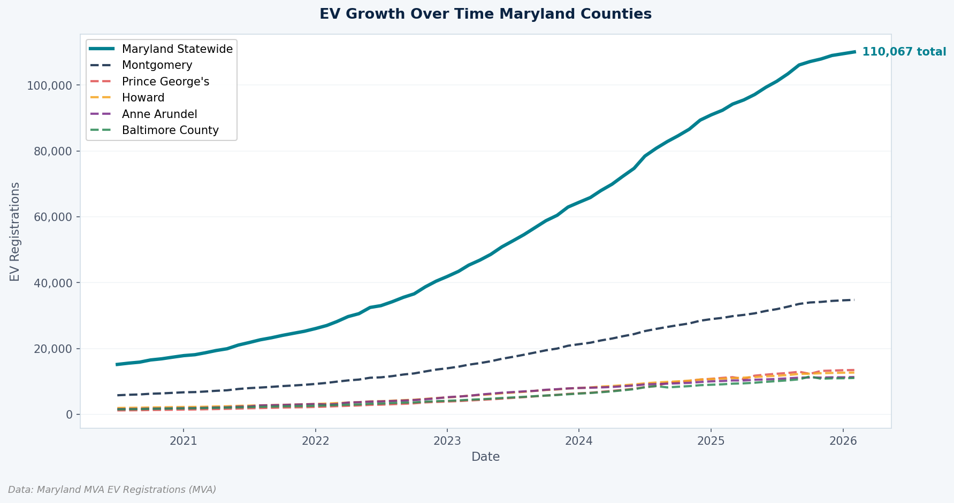
EV Growth Over Time in Maryland

Slide 5
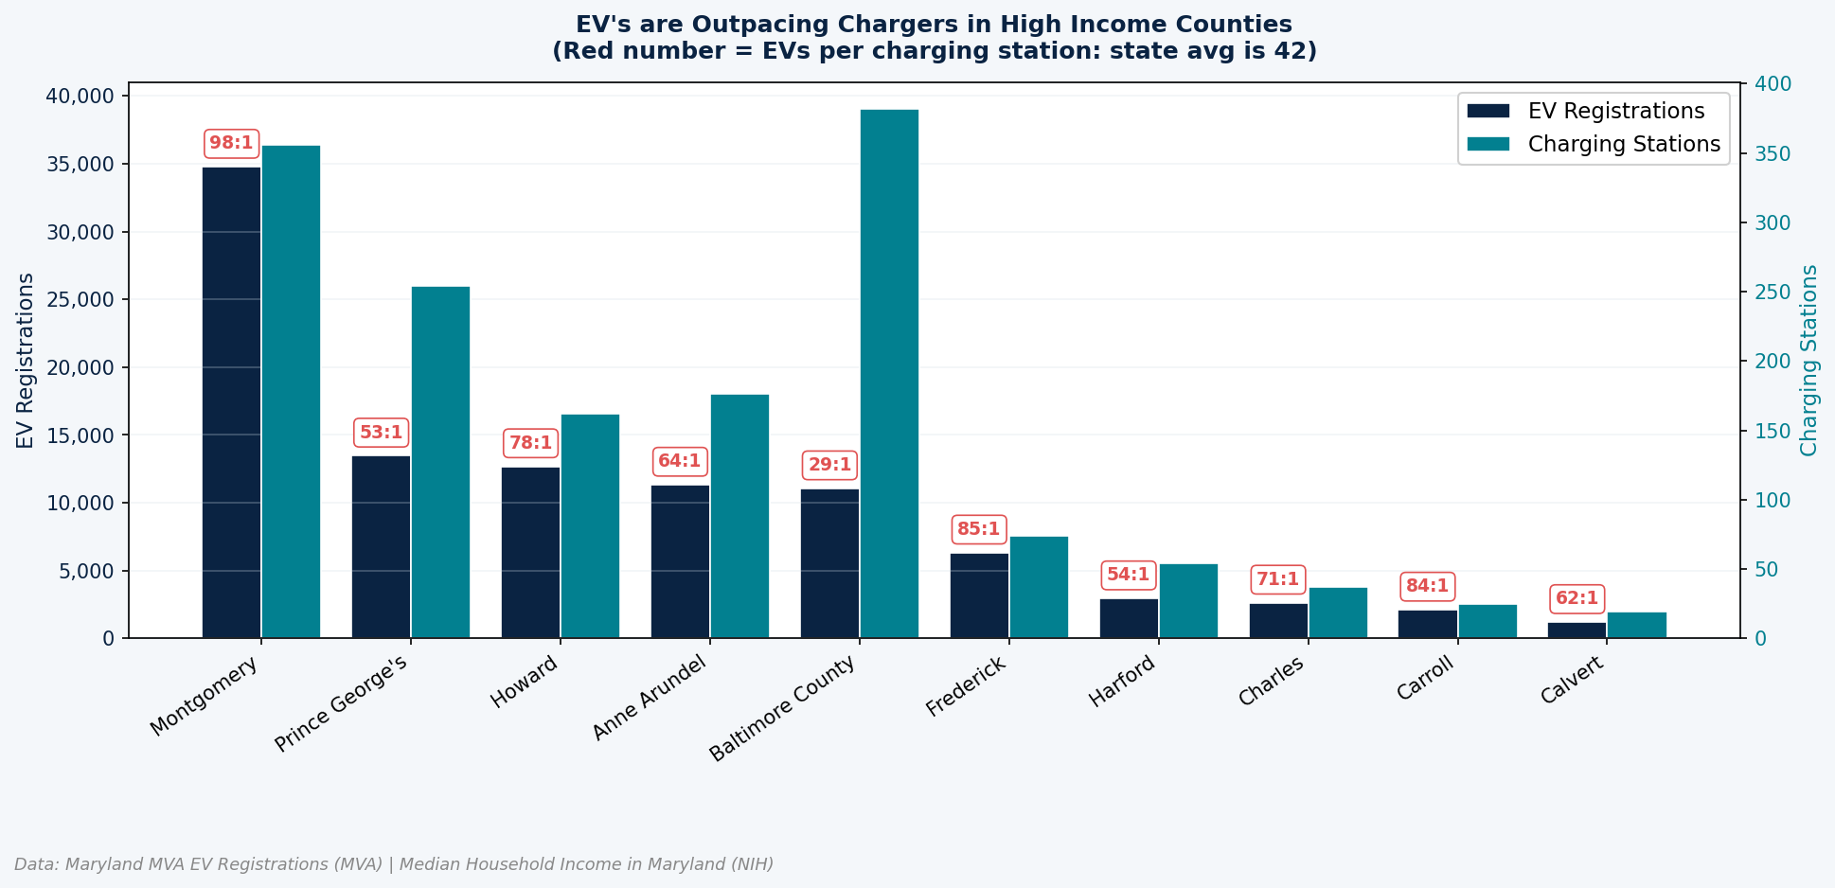
EV to Charger Ratios by County

Slide 6
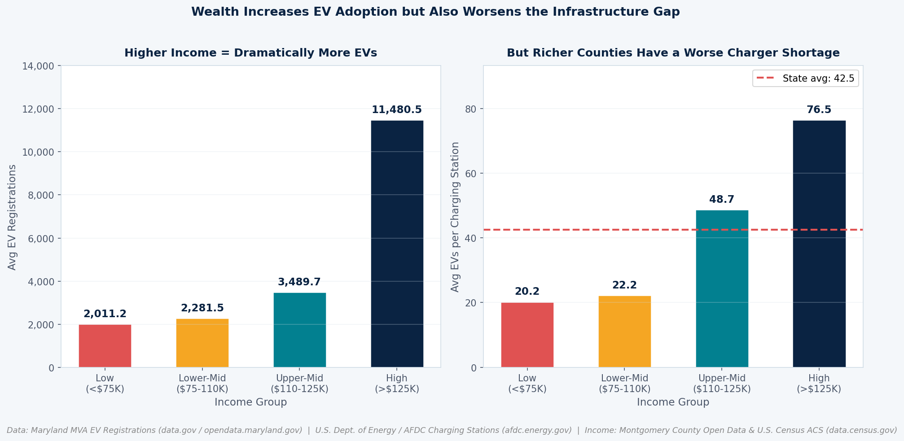
Rich Counties Have a Worse Charger Shortage

Slide 7
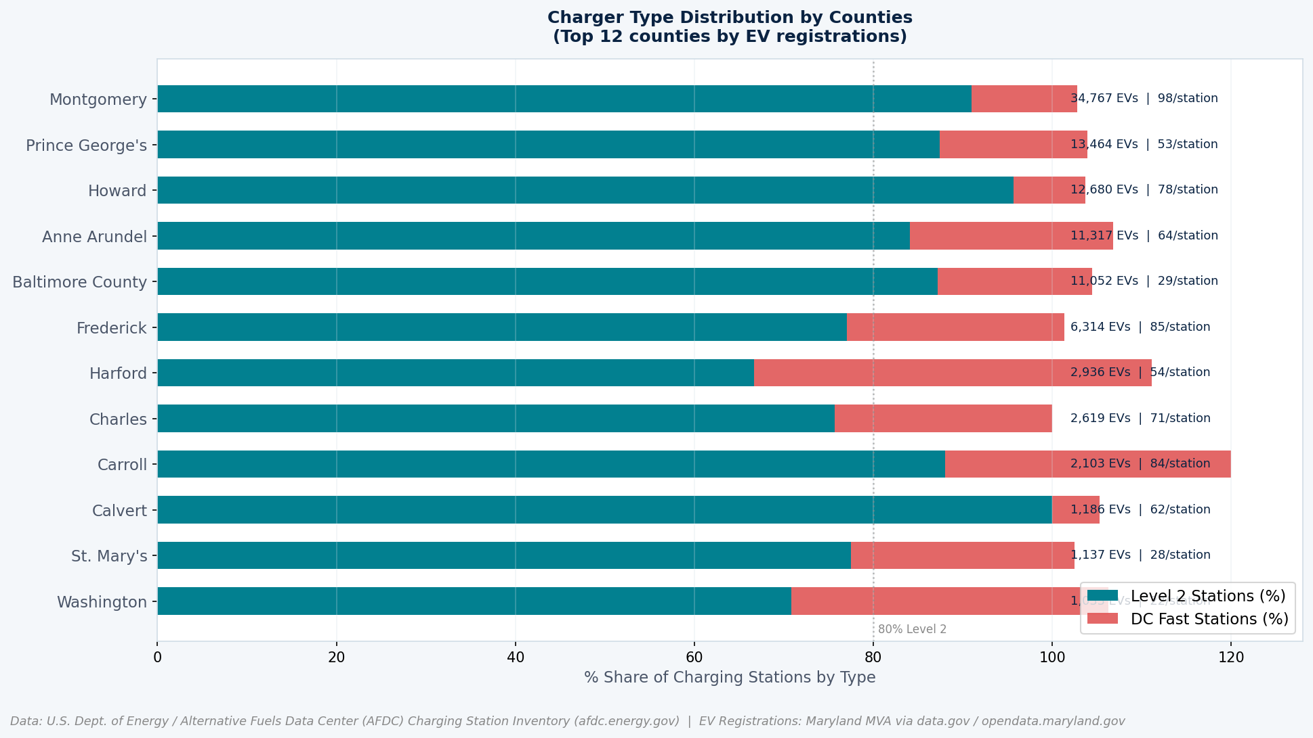
Charger Type Distribution by Counties

Slide 8
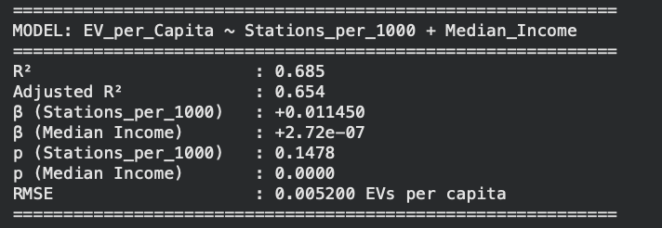
What Drives EV Adoption?
Uses EVs per capita to compare counties fairly
Uses stations per 1,000 residents to measure charging access
R² = 0.685: model explains about 68.5% of variation in EV adoption rate
Stations_per_1000: positive relationship, but not statistically significant
Median income: positive and statistically significant
Main takeaway: income is the stronger predictor after adjusting for population
Assumptions were reasonably met, but results should be interpreted carefully because the model only uses 23 counties.

Slide 9

Why Does Montgomery County Dominate?
Dealership Partnerships
County programs work directly with dealerships to offer discounted EV pricing and promote EV sales
Strong Climate Policy
Montgomery County’s Climate Action Plan is a framework to reduce GHG by 100% by 2035
Economic Advantage
$117,000 Median income per household. Lowers the EV purchasing barrier.

Slide 10
Take aways
EV adoption is growing faster than infrastructure
EV-to-Charger ratio only increases.
EV growth is concentrated in a few counties.
Top 5 Counties have more EV’s than the rest combined.
Income is the strongest predictor for EV adoption
Higher income counties have higher EV adoption rates after adjusting for populations
Infrastructure gaps are largest in high-demand areas
Counties with more EV’s have a bigger charger shortage

Slide 11
Reflection
What Was Challenging
What Was Rewarding
Next Steps
Merging datasets cleanly. County names were formatted differently across all datasets.
Small sample size (23 counties) limits statistical power and gives outliers like Montgomery County.
Turning Data into a Story. Going from raw datasets to clear insights and a full narrative was one of the most satisfying parts
Working with Real Data. Analyzing real Maryland EV and infrastructure data made the project feel practical and relevant
Build a Predictive Model. Forecast EV adoption through 2030.
Engage with Policymakers. Contact officials to help with planning.
Incorporate Emissions Data.
Add more variables. (home ownership, commute distance)

Slide 12

Acknowledgments
Special thanks to Professor Alraee
Thank you Professor Saidi
Thank you Professor Peri
Thank you Data Science Cohort.
Thank you Montgomery County Government
Thank you Data Montgomery

Slide 13
Sources
Montgomery County Launches Maryland’s First ‘EV Purchasing Co-op Dealership Incentive Program’ to Share Information and Reduce Cost of Buying Electric Vehicles - https://conduitstreet.mdcounties.org/2022/12/20/montgomery-launches-ev-purchasing-co-op-dealership-incentive-program/
EV Rebates in Bethesda, MD: 2025–2026 Guide to Credits & Incentives - https://recharged.com/articles/ev-rebates-bethesda-md?srsltid=AfmBOopGmjf0bHTTTc7QTgHA8cJNkVKKWv3Yzd-ERWOGlAPbGspY_U3D
Maryland Department of Environment - https://mde.maryland.gov/programs/air/ClimateChange/Documents/2030%20GGRA%20Plan/THE%202030%20GGRA%20PLAN.pdf

